Slide 1

ARIF BUDIMAN
Tempat, tgl lahir :
Padang, 28 july 1994
Alamat :
Buaran, jakarta Timur
Hobi :
Hiking, Surfing, Musik
Pendidikan :
Universitas Putra Indonesia “YPTK”
HELLO

Slide 2
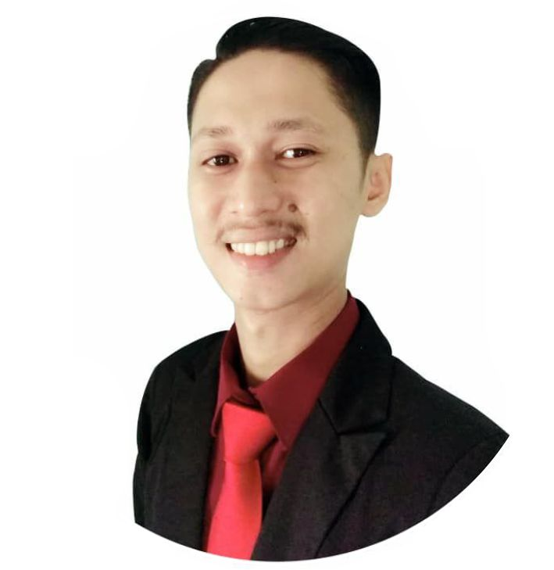










Technical Skills
On the way to be expert.
PHP
Laravel
CorelDraw
Node Js
Java
MariaDB
SQL
@aboee27
@aboe27
aboe27

